Slide 1
Group
Members:
Hanz bruen roca
Janus Christian clores
Ephraim Henson
Arjay budol

Slide 2
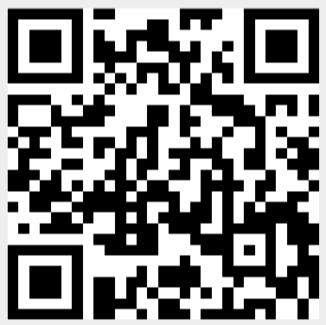
The qr code
Scan to open the app…

Slide 3

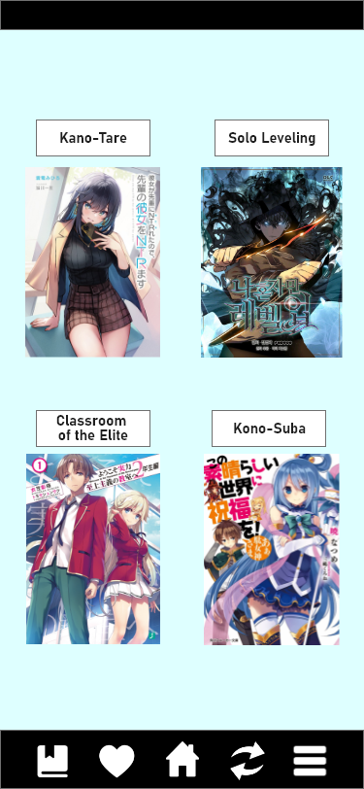
The interface
You can view the contents of the app after scanning the QR Code…

Slide 4
The diagram
HEADER
LOGO
Shows how the interface are designed…
DESCRIPTION
BUTTON
FOOTER

Slide 5
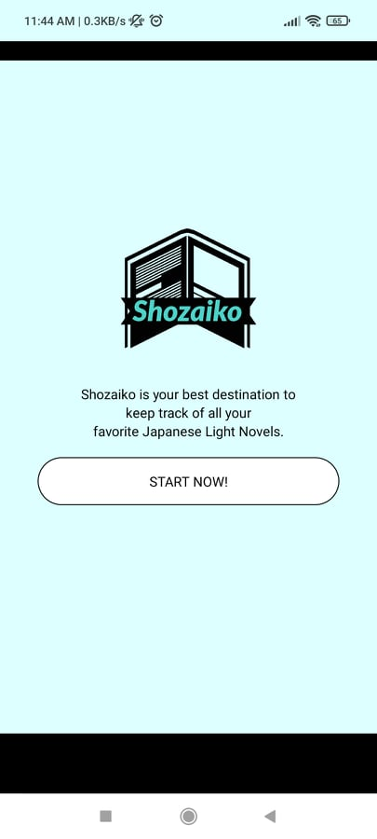
The ACTUAL output
The actual output of our endeavor in making a prototype application…

